Slide 1








SES MDI using SDC/SDPi+FHIR Framework & Considerations
Pre-release
Draft 2020.07.23
ADD UML MODEL
UPDATE Gardens \Diagram
Establishing a framework for
Trusted Interoperable Product Decoupling
FHIR is a trademark of Health Level 7, International.
SDC is a registered trademark of OR.NET

Slide 2
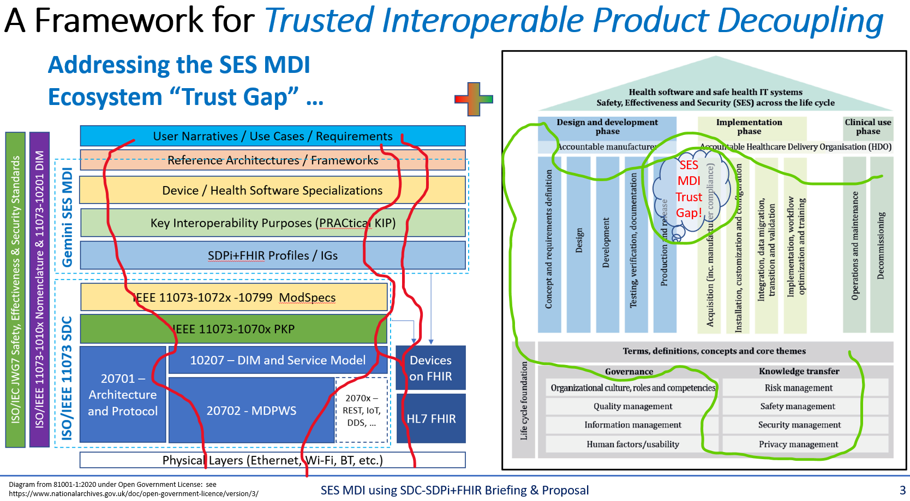
SES MDI Using SDC/SDPi+FHIR – The Big Idea
Full presentation available @ Gemini SDPi+FHIR “The SES MDI Interoperability Trust Gap” @ https://confluence.hl7.org/x/IQ7xB

Slide 3
Questions to Contemplate …
How to minimize duplication of information & effort?
How to maximize use of work and resources already created?
What is the requirements starting point & ending point?
How to truly integrate SES & MDI … seamlessly?!
How to craft a framework for SES “PnT” MDI …
… With an achievable starting point & compelling future state?

Slide 4
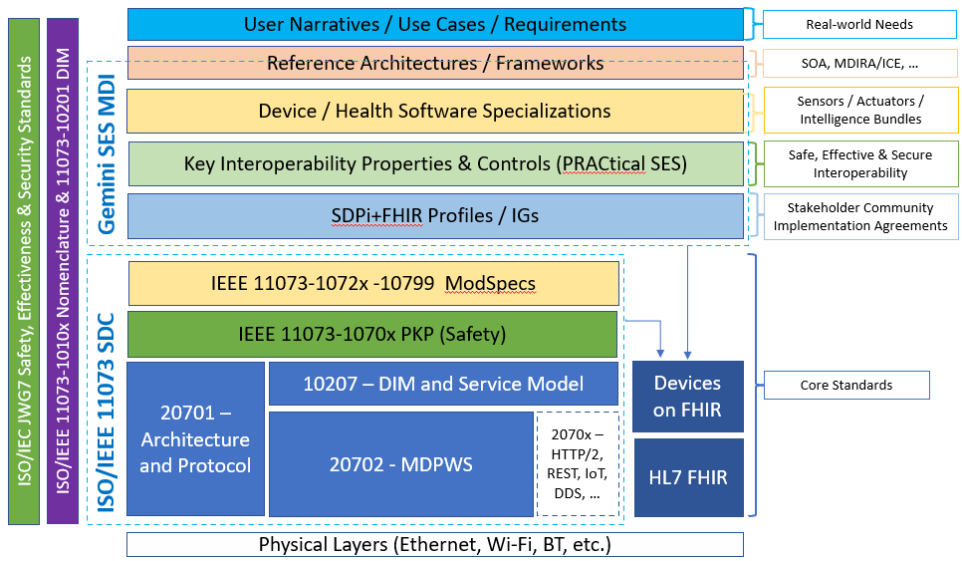
SES MDI Using SDC/SDPi+FHIR – The Big Picture
“Hanging Gardens” Model
Perfect? Not!
Useful? Absolutely!!!
Provides a common reference point to consider the questions and identify a workable framework
Cuts across …
Standards
Organizations
Subject Areas
Past/Present/Future
….

Slide 5
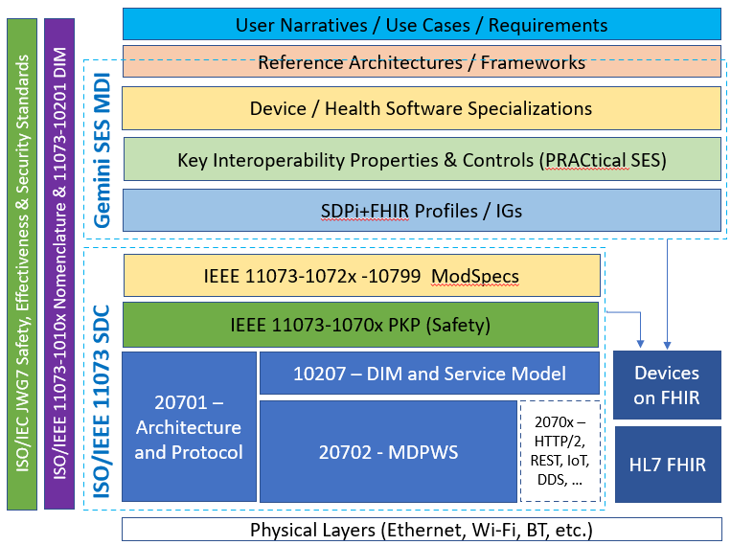
“Hanging Gardens” Model – Layer Integration
Each layer can be characterized by:
Unique Subject Concepts & Components (Terms)
Layer-specific Information & Knowledge (UML models)
Layer API & Capabilities & Requirements (Inter-layer Spec’s)
Requirements Formalization (Gherkin & ReqIF Spec’s)
Implementation Trust Logic (SES Assurance Case Spec’s)
Implementation Technology Logic (MDI Spec’s)
Integrating each “hanging garden” can be achieved by “threading” …
horizontally – across layer-specific characterization dimensions
+
vertically – mapping from scenarios to Plug-and-Trust decoupled product interfaces

Slide 6
Layer Characterization: Horizontal & Vertical
Horizontal
(Intra-Garden Walkways)
Vertical
(Inter-Garden Stairways)
Unique Subject Concepts & Components (Terms)
Each Layer Characterized Horizontally
&
Integrated Vertically
Layer-specific Information & Knowledge (UML models)
Layer API & Capabilities & Requirements (Inter-layer Spec’s)
Requirements Formalization (Gherkin & ReqIF Spec’s)
Implementation Trust Logic (SES Assurance Case Spec’s)
Implementation Technology Logic (MDI Spec’s)

Slide 7
Garden Design: Horizontal Integration
Unique Subject Concepts & Components (Semantics/Terms)
Concepts, terms, definitions, algorithms, frameworks, …
Layer-specific Information & Knowledge (UML models)
Use Case / Activity Diagrams, Sequence Models, Object Models, etc.
Layer API & Capabilities & Requirements (Inter-layer Spec’s)
“API” Specifications, Implementation “Platform” Requirements, etc.
INCLUDE MAPPING COMPONENT / ARTIFACTS + standards in scope
Create a UML model showing relationships
Requirements Formalization (Gherkin & ReqIF Spec’s)
Feature, Rule, Given/When/Then + Specification, SpecRelation (Source, Target), etc.
Implementation Trust Logic (SES Assurance Case Spec’s)
Profiled application of 81001-1, 80001-1, 62304, assurance cases, etc.
Implementation Technology Logic (MDI Spec’s)
System Actors, Transactions, Messages, Events, Terminology, Value Sets, etc.

Slide 8
Garden Design: Vertical Integration
Unique Subject Concepts & Components (Semantics/Terms)
Concepts, terms, definitions, algorithms, frameworks, …
Layer-specific Information & Knowledge (UML models)
Use Case / Activity Diagrams, Sequence Models, Object Models, etc.
Layer API & Capabilities & Requirements (Inter-layer Spec’s)
“API” Specifications, Implementation “Platform” Requirements, etc.
Use Case(s) to SOA to DS to KIP(SES) to SDPi to SDC to SFC
Requirements Formalization (Gherkin & ReqIF Spec’s)
Feature, Rule, Given/When/Then + Specification, SpecRelation (Source, Target), etc.
Implementation Trust Logic (SES Assurance Case Spec’s)
Profiled application of 81001-1, 80001-1, 62304, assurance cases, etc.
Implementation Technology Logic (MDI Spec’s)
System Actors, Transactions, Messages, Events, Terminology, Value Sets, etc.

Slide 9
Layer Characterization: Horizontal & Vertical Model
CREATE A UML MODEL SHOWING ALL THE BITS THAT GET INTEGRATED HORIZONTALLY & VERTICALLY
Horizontal
(Intra-Garden Walkways)
Vertical
(Inter-Garden Stairways)
Unique Subject Concepts & Components (Terms)
Each Layer Characterized Horizontally
&
Integrated Vertically
Layer-specific Information & Knowledge (UML models)
Layer API & Capabilities & Requirements (Inter-layer Spec’s)
Requirements Formalization (Gherkin & ReqIF Spec’s)
Implementation Trust Logic (SES Assurance Case Spec’s)
Implementation Technology Logic (MDI Spec’s)

Slide 10
Garden: Use Case Scenarios
Unique Subject Concepts & Components (Terms)
Narrative Stories, Actors (People & Systems), Scenarios, Activities, …
Layer-specific Information & Knowledge (UML models)
Use Case / Activity Diagrams, Sequence Models, Object Models, etc.
Layer API & Capabilities & Requirements (Inter-layer Spec’s)
“API” Specifications, Implementation “Platform” Requirements, etc.
Update layout to focus on Use Case Stuff – Minimize horizontal / vertical
Add layer Scope / Garden Theme
Requirements Formalization (Gherkin & ReqIF Spec’s)
Feature, Rule, Given/When/Then + Specification, SpecRelation (Source, Target), etc.
Implementation Trust Logic (SES Assurance Case Spec’s)
, etc.
Implementation Technology Logic (MDI Spec’s)
Actors, Transactions, Messages, Events, Terminology, Value Sets, etc.

Slide 11
Garden: Reference Architectures
Architecture layer
Include: MDIRA/ICE and SDC/SOA examples

Slide 12
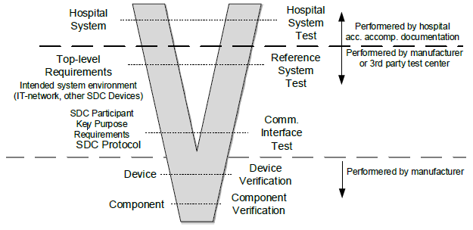
Garden: Key Interoperability Purposes (SES)
SES KIP
Includes:
SES profiles @ MDI standards
Assurance Case Templates
Interoperability model(s)
4 Key Purpose Areas for MDI
Profiles for applying SES standards to SDC/SDPi+FHIR (incl. 81001-1, 80001-1. 82304, 62304, etc.)
INCLUDE 81001-1 / 80001-1 REQUIREMENTs that are aligned with LIFECYCLE PHASES including RIGHT SIDE STAKEHOLDERS and filling in “open” requirements => provisioned to device (via PKI?) and including arch requirements etc. [baseline PnT + “value added” for enhanced SES] *** Usability of Device Coupling Strategies, PnT, …
SFC spec includes SES requirements that COULD / MUST be completed in the Deployment RM … + how formalized in the PKI/EKU provisioned at implementation?

Slide 13
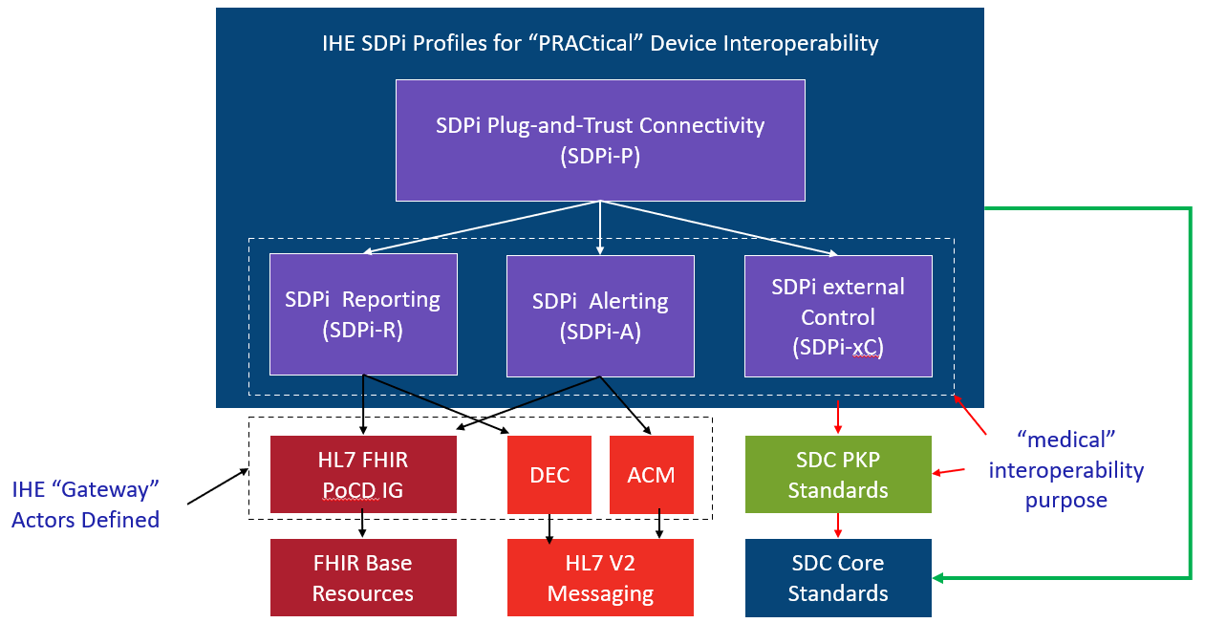
Garden: IHE SDPi
IHE SDPi
IHE TF Constructs:
Use Cases (actors, transactions

Slide 14
Garden: ISO/IEEE 11073 SDC
SDC – ModSpecs, PKP, BICEPS, SOMDA, MDPWS
<? 5 slides or one or … ???>
<include mapping to TF volumes>
Integrated Rxxxx
BICEPS model
SOMDA Model
WS-*

Slide 15
Hanging Gardens: Pulling it all together …
SES MDI (TF-1 Appendix A)
SFC – Specification / formalization / organization / …
Assurance Cases – composable / computable / V&V’able / CA’able
SES Requirements – per 81001-1, 80001-1, 60601-x-y, 62304, etc.
KIP(Regulatory) – sans implementation tech (see earlier slide)
CA @ SFC …
ACID TEST:
Requirement Test: Verify that PKP OID is in a device’s security certificate
Challenge: Do we know WHY it has to be there? Can we trace that requirement to the initial layer (Scenario?) that mandated its inclusion?

Slide 16
Additional
Information

Slide 17
OMG Requirements Interchange Format (ReqIF) “Mapping”
Background

Slide 18
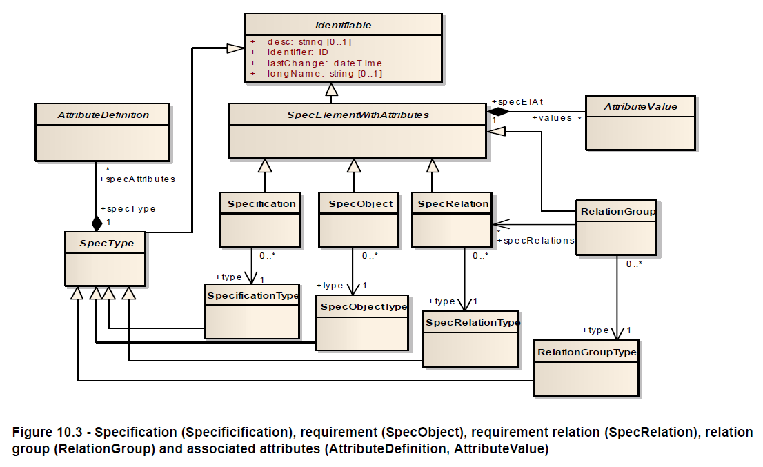
OMG ReqIF: Base Model

Slide 19
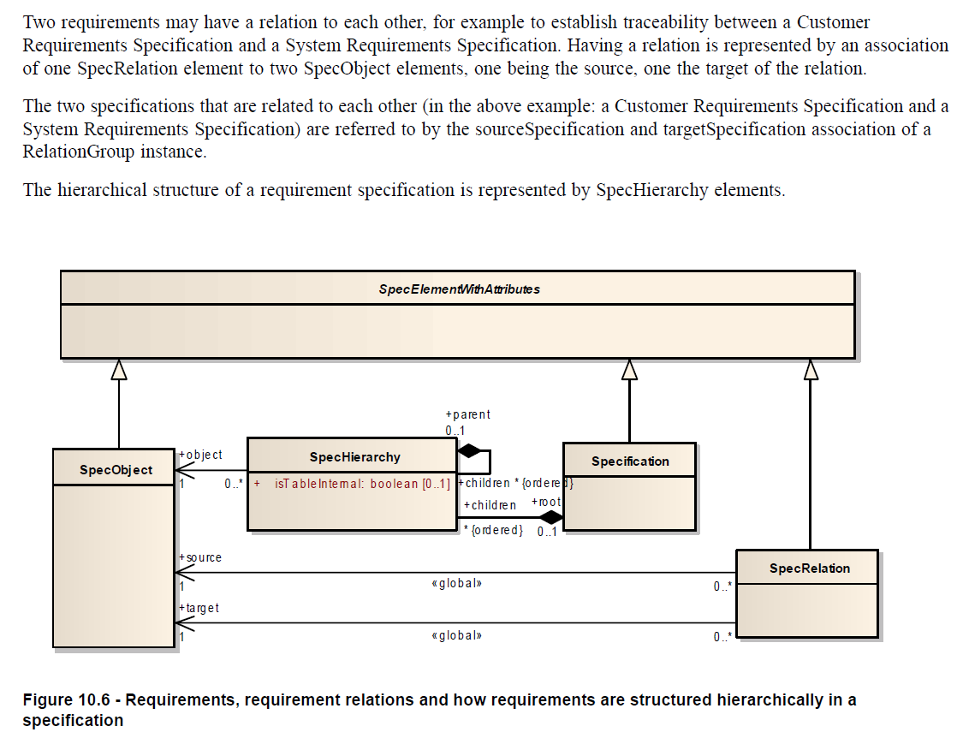
ReqIF: Requirement Hierarchies & Relationships
“mapping” between
Source & Target Requirements

